Slide 1
WW Panel SMLD Database Building Status

Slide 2
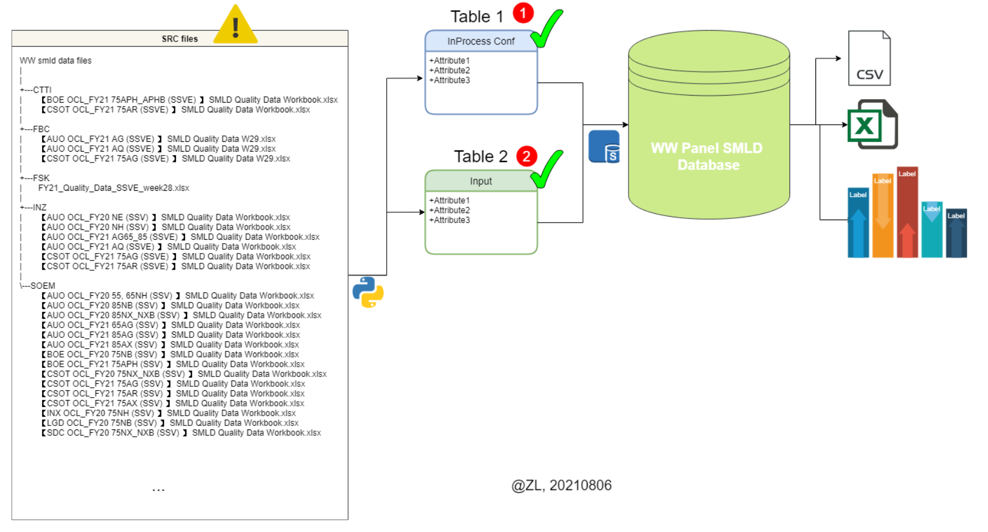
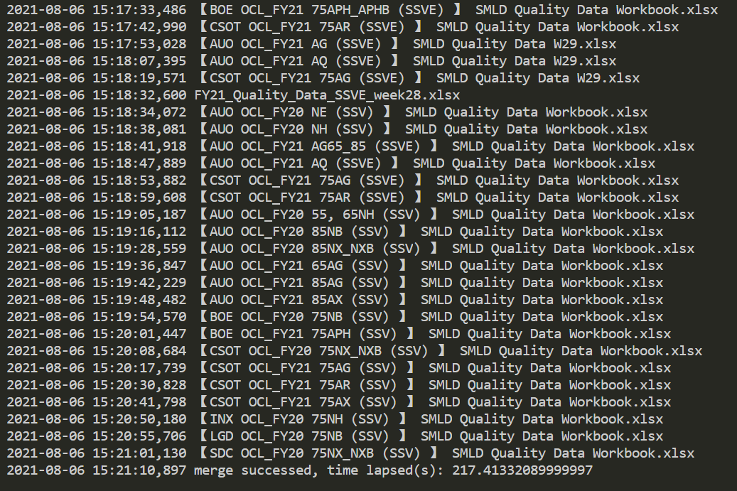
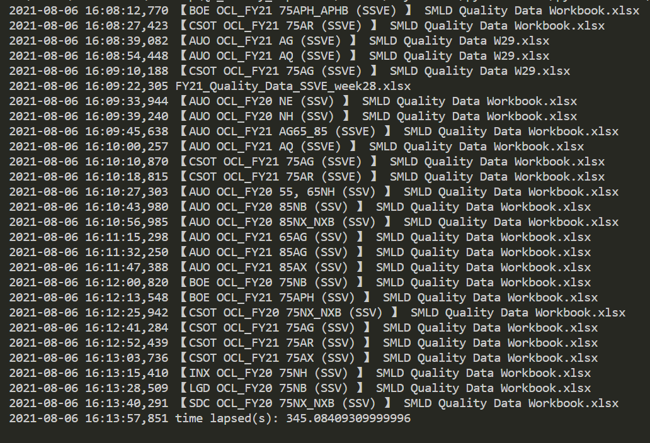
WW Panel SMLD | Control System
Purpose
Build a database to manage WW Panel SMLD and monitor WW Panel Quality at weekly pace.
Schema
Please refer to fig.1
Tools
[*] using Python + SQL
[x] using VB.NET or VBA
Problems
In SRC files problems. Please refer to P.3
Performance
Table1(“InProcess Config”), time lapsed(s): 217
Table2(“Weekly Input per PMOD”), time lapsed(s): 345
TTL: 9.4min
=> this is far from perfect but it works as expected due to the natural performance when working with Excel files
Fig.1
Table1 performance
Table2 performance

Slide 3
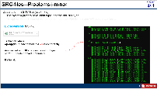
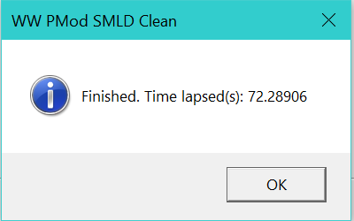
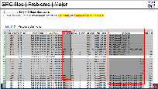
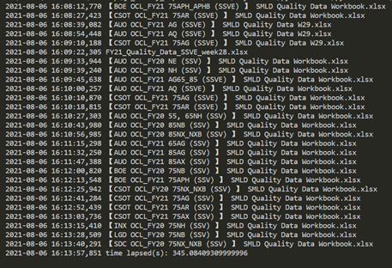
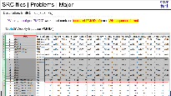
Source Data File Problem [Cleared]
Problems | Solution | Performance
Comment | ClassModel API is well-tested | this preprocess is better than using Python
using VBA to create a class to handle
Error1: file extension error
’CPModWrangler ClassModel
Public Sub clean()
Call clean_inProcess
Call clean_Inputs
Call clean_fileType
End Sub
time lapsed(s): 72.8 using VBA
✔
Error2: important data miss
time lapsed(s): 345 using Python
Error3: data format error
✘

Slide 4
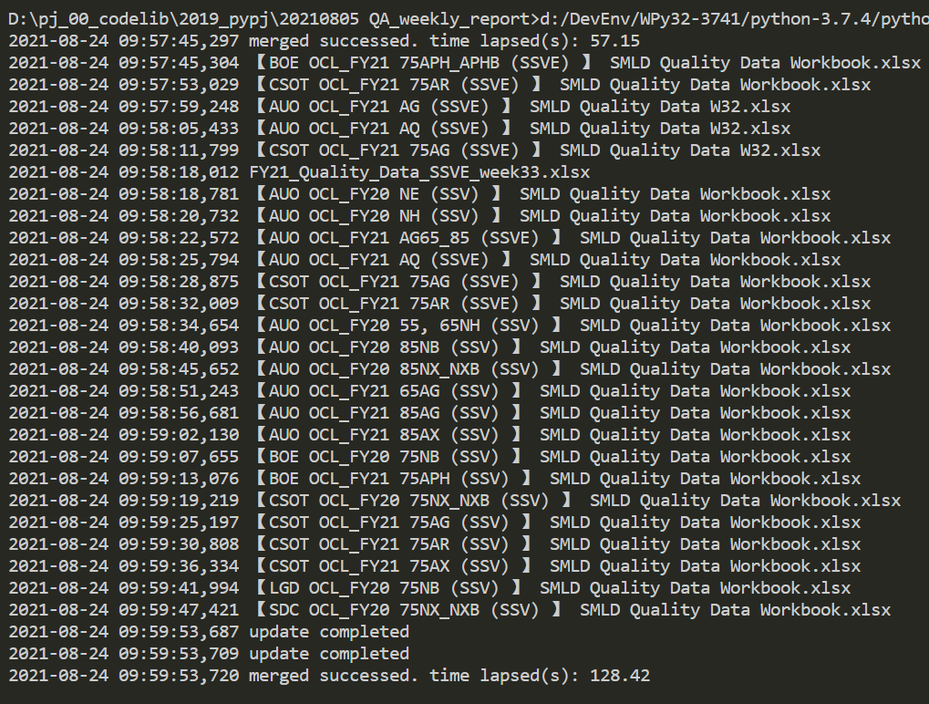
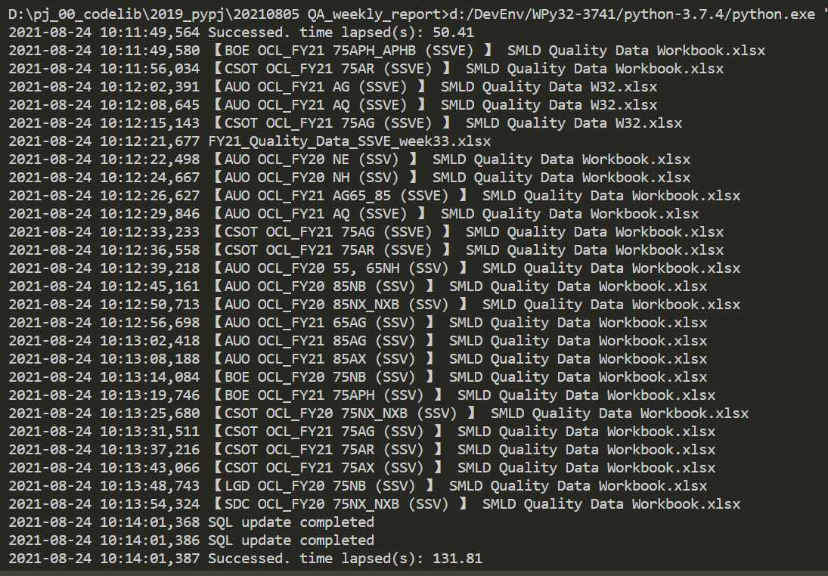
Performance
1st Run
2nd Run
VBA预处理
Python -> SQL
Conclusion:
VBA preprocess: 57.15s
Python -> SQL took 128.42s
Performance: 185s(3min), speed +66%

Slide 5
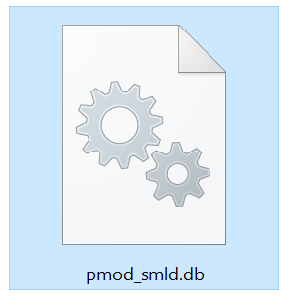
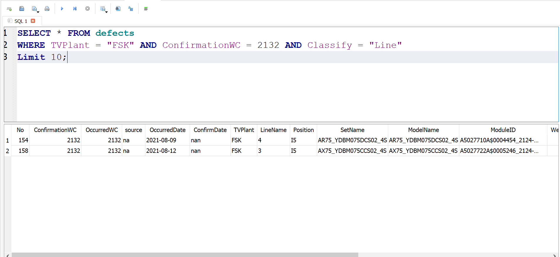
SQL Database
Conclusion:
SQL Database is ready

Slide 6
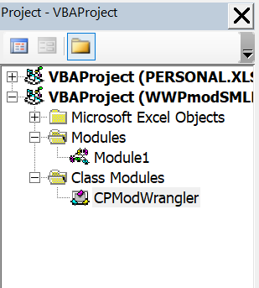
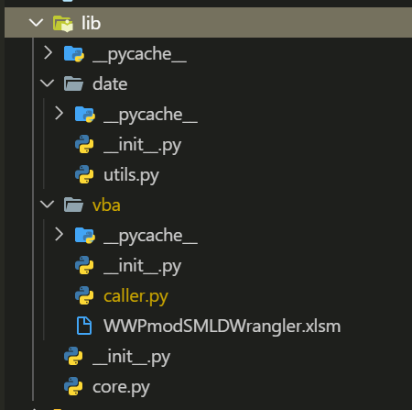
Release-ready Build
VBA preprocess class API
Python class Merger API
Conclusion:
VBA preprocess class API is well-tested and ready to release
Python merger API is well-tested and ready to release

Slide 7
TODO
1. make an application with GUI for normal users @ZL

Slide 8
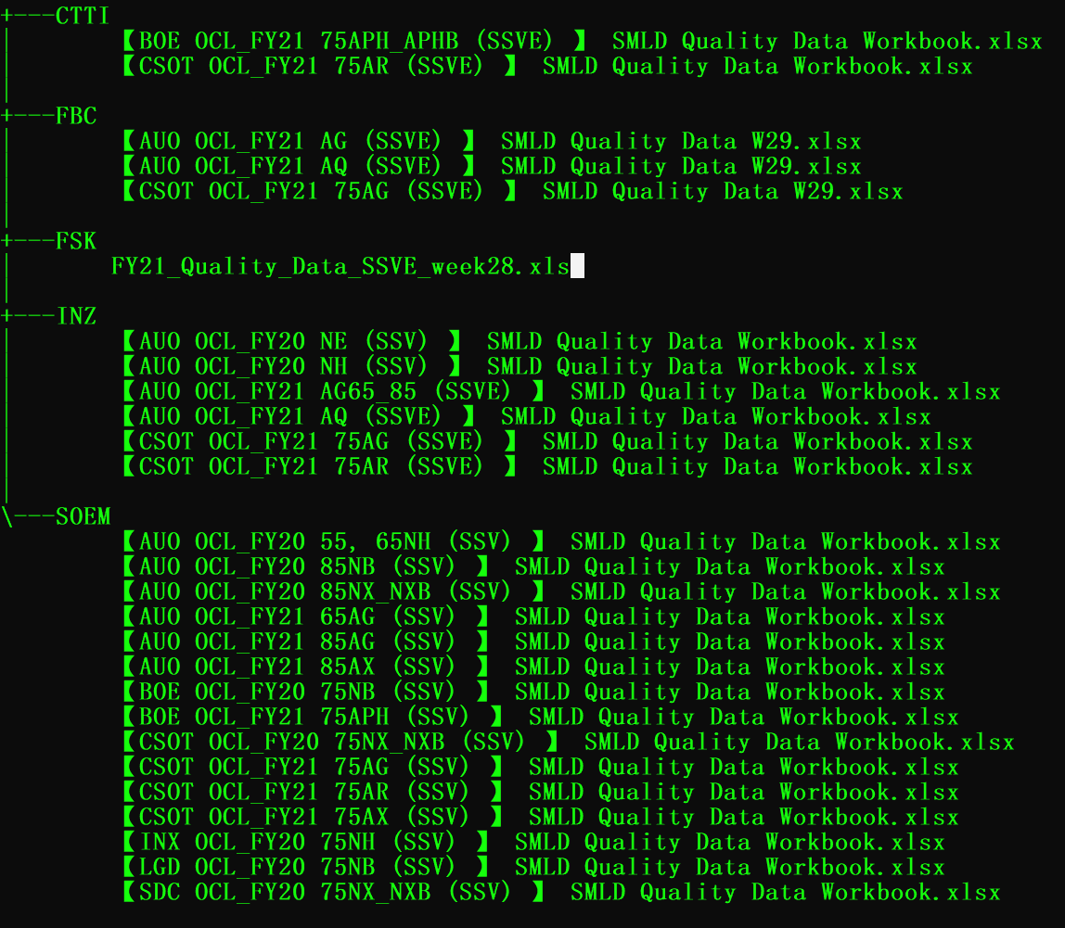

SRC files | Problems | minor
Description: In SRC files(.xlsx, .xls),
The system prefers new .xlsx type, not the old .xls type
“Graph or Report” worksheet contains inconsist PMOD info and WK sequence format.
Excel version(“FSK”),
Technical Details
openpyxl lib can’t handle old .xls files correctly.
Anyway, either FSK changes its output type
or SSVE has to convert it manually.
It’s trivial.

Slide 9
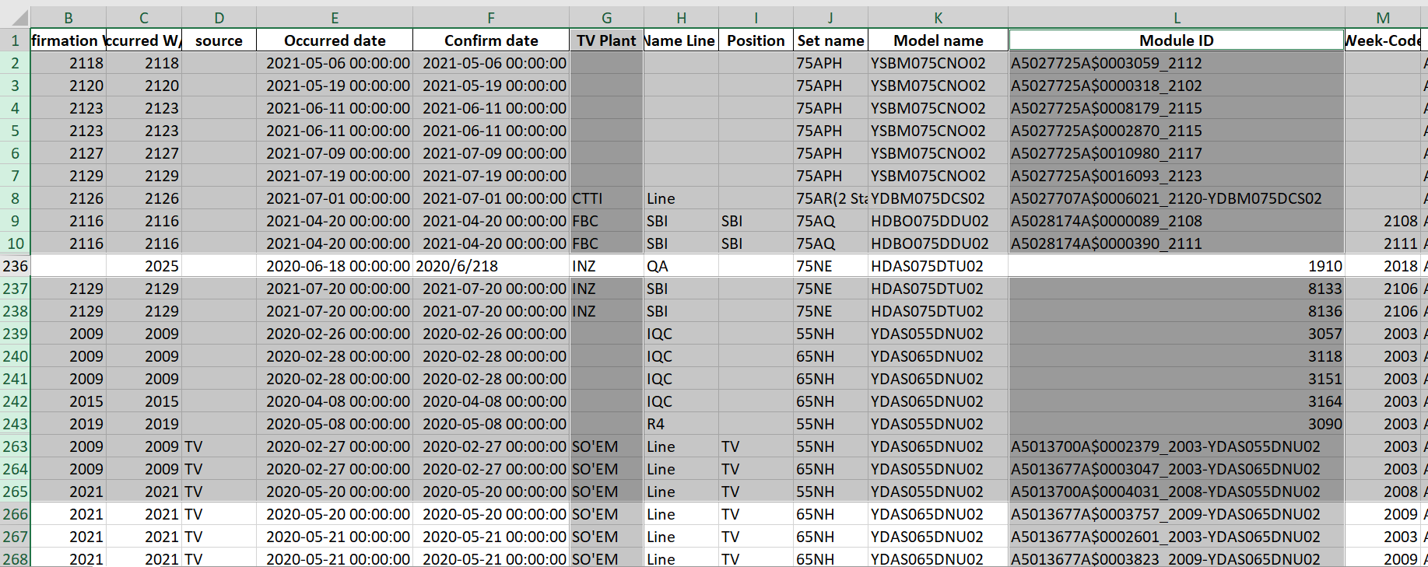
SRC files | Problems | Major
Description: In SRC files(.xlsx, .xls),
“InProcess Config” worksheet contains null data, or data format is inconsist.
“Graph or Report” worksheet contains inconsist PMOD info and WK sequence format.
Table1(“InProcess Config”),

Slide 10
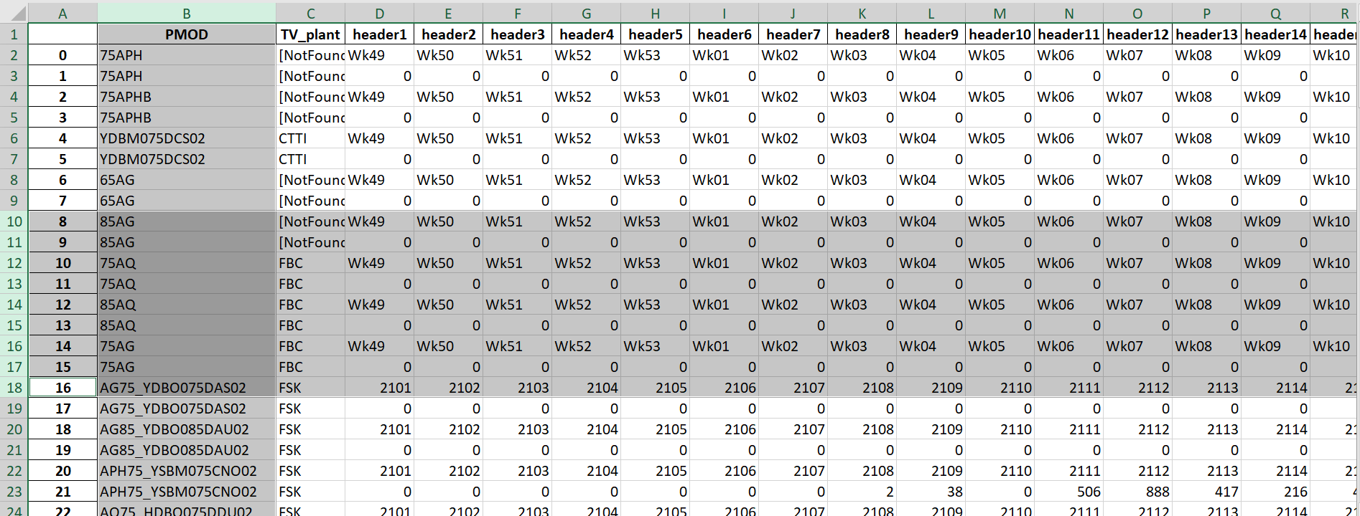
SRC files | Problems | Major
Description: In SRC files(.xlsx, .xls),
“InProcess Config” worksheet contains null data, or data format is inconsist.
“Weekly Input per PMOD” worksheet contains inconsist PMOD info and WK sequence format.
Table2(“Weekly Input per PMOD”),

